Slide 1

Natural language processing

Slide 2

AGENDA
What is NLP?
chatbots & Virtual Assistants
Language Translation
Speech Recognition
Sentiment Analysis
Healthcare Analytics
Smart Recommendations

Slide 3

Natural Language Processing (NLP) Is a field of artificial intelligence (AI) focused on enabling machines to understand, interpret, and generate human language. It combines computer science, linguistics, and machine learning.
Natural Language Processing (NLP)

Slide 4

Why is it important?
Because most of our communication is through language—spoken or written—NLP helps machines interact with humans in a natural way. It powers things like voice assistants, chatbots, and language translation.

Slide 5
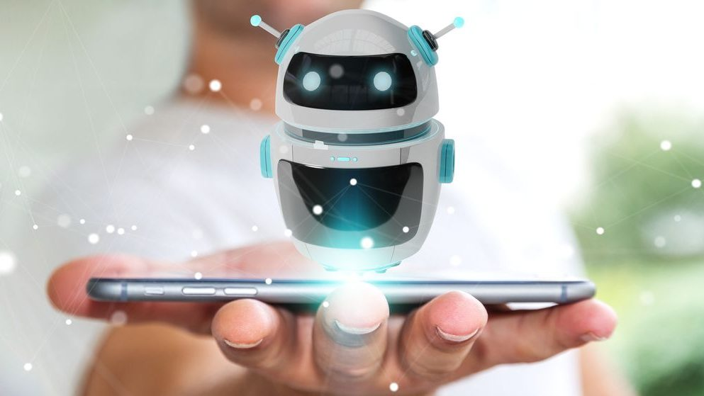

Chatbots & Virtual Assistants
Chatbots & Virtual Assistants
Examples: Siri, Alexa, ChatGPT
Functions: Answering queries, scheduling, basic conversation
NLP Role: Intent recognition, context understanding, response generation
This Photo by Unknown Author is licensed under CC BY
This Photo by Unknown Author is licensed under CC BY-NC-ND

Slide 6

Language Translation
Tools: Google Translate, DeepL
Impact: Breaks language barriers, global communication
NLP Role: Neural machine translation, syntax and semantics handling
This Photo by Unknown Author is licensed under CC BY

Slide 7

Speech Recognition
Examples: Voice assistants, call center automation
Function: Converts speech to text
NLP Role: Transcription, voice commands, speech-to-intent systems
This Photo by Unknown Author is licensed under CC BY-SA-NC

Slide 8

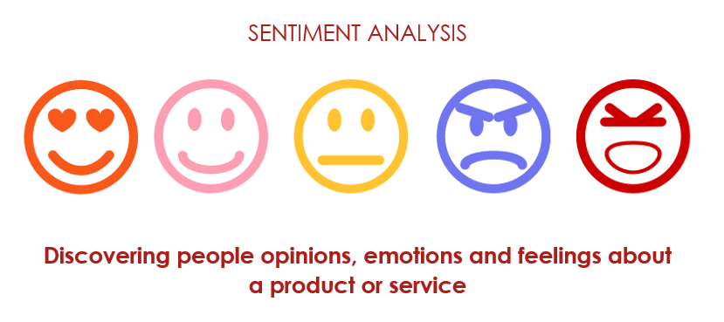
Sentiment Analysis
Used in: Social media monitoring, customer feedback
Goal: Understand opinions and emotions
NLP Role: Polarity detection (positive, neutral, negative), emotion tagging
This Photo by Unknown Author is licensed under CC BY-SA

Slide 9

Healthcare Analytics
Applications: EHR analysis, diagnostic assistance, patient feedback
NLP Role: Extracting information from clinical notes, summarizing records
This Photo by Unknown Author is licensed under CC BY-NC-ND

Slide 10

Smart Recommendations
Used in: E-commerce, streaming platforms
How NLP Helps: Analyzes user reviews, behavior, and queries to suggest relevant items
This Photo by Unknown Author is licensed under CC BY-SA-NC

Slide 11

Conclusion
NLP is driving smarter systems across industries.
The future: more personalized, natural, and multilingual interaction with machines.

Slide 12

THANK YOU
Brita Tamm
502-555-0152
brita@firstupconsultants.com
www.firstupconsultants.com

